Slide 1
Mod Assist & Vendor Portal
Presented to:
CAV Symposium
Presented by:
Gregory Craven
NAVSUP WSS Contracting Post Award Lead
1 Sept 2026

Slide 2

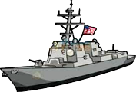
Mod Assist Module
What is Mod Assist?
NAVSUP WSS built and maintained system for tracking mod requests on WSS and DLA Weapons Support contracts. Not for use with other agencies’ contracts.
Overhauled in 2025 to provide better visibility of modification requests for WSS Contracting workforce.
Paired with the Vendor Portal providing functionality for industry partners to submit mod requests directly into Mod Assist
Repair Modification Process
READY. RESOURCEFUL. RESPONSIVE.

Slide 3





Mod Assist Functionality
Mod Assist Functionality:
Improves Audit Readiness
Internal centralized and documented modification database
Provides increased visibility of all post award requests
Enhances Communication
Historically stove-piped process between industry, IWST, CAV, and KO
Identify and submit contract modification requests
Process contract modifications
DCMA receives modification via EDA timely which allows for WAWF updates expeditiously
Reduce administrative timeline
Tailored Reports for workload management
Improve Asset visibility
Query ability ranges: duration, contractor, NIIN, and CLIN/SLIN.
READY. RESOURCEFUL. RESPONSIVE.

Slide 4
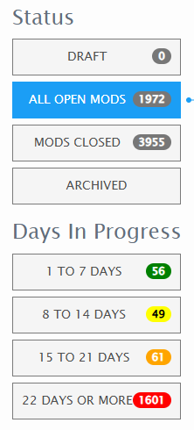
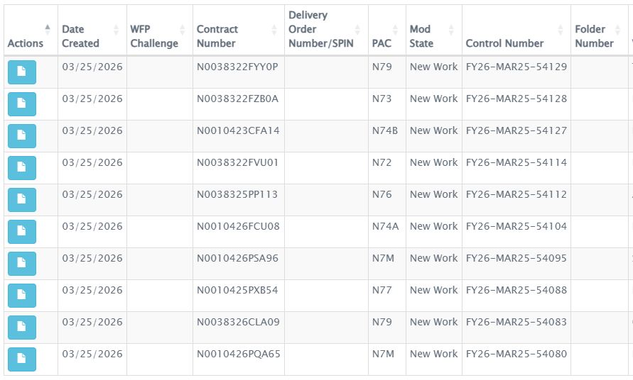
Mod Assist Module
Government User View in Mod Assist
READY. RESOURCEFUL. RESPONSIVE.

Slide 5
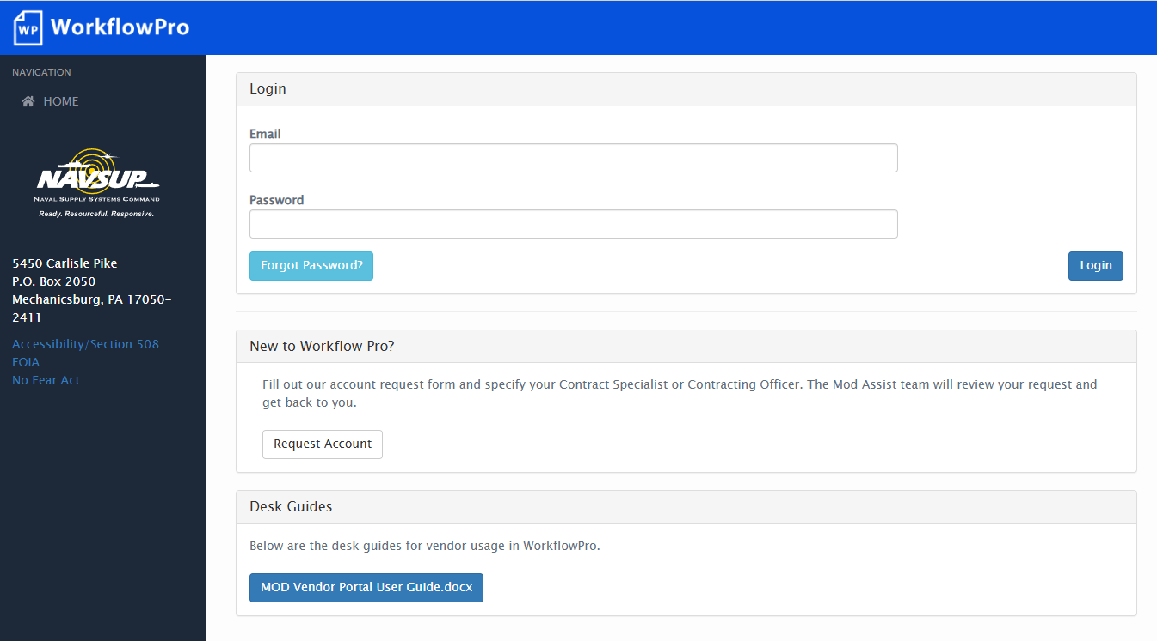
Mod Assist Vendor Portal – Request an account
Vendor portal address:
  https://mynavsup-public.nag.navy.mil/public/ops$workflow_pro_public.login
  User Guide posted on login page
READY. RESOURCEFUL. RESPONSIVE.

Slide 6
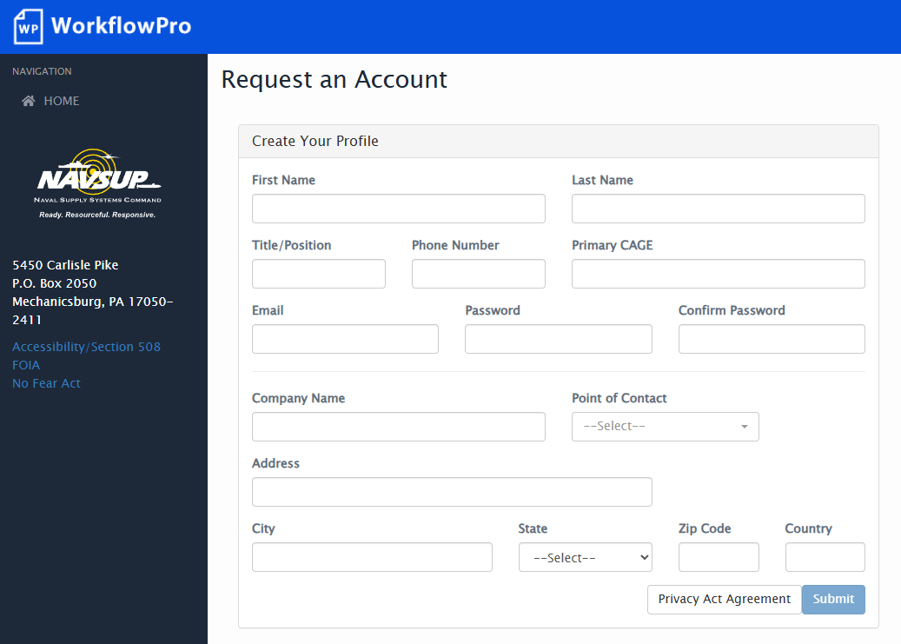
Mod Assist Vendor Portal – Request an account
Vendors may request access via the system. Access requests are routed to the Contract Specialist for review/approval.
Point of Contact
  This is a Contracting Specialist who knows that you work with the CAGE. If there is no one, reach out to the Mod Assist Support Email at: usn.philadelphia.navsupwssphil.mbx.mod-assist@us.navy.mil
Review the Privacy Act Agreement
READY. RESOURCEFUL. RESPONSIVE.

Slide 7
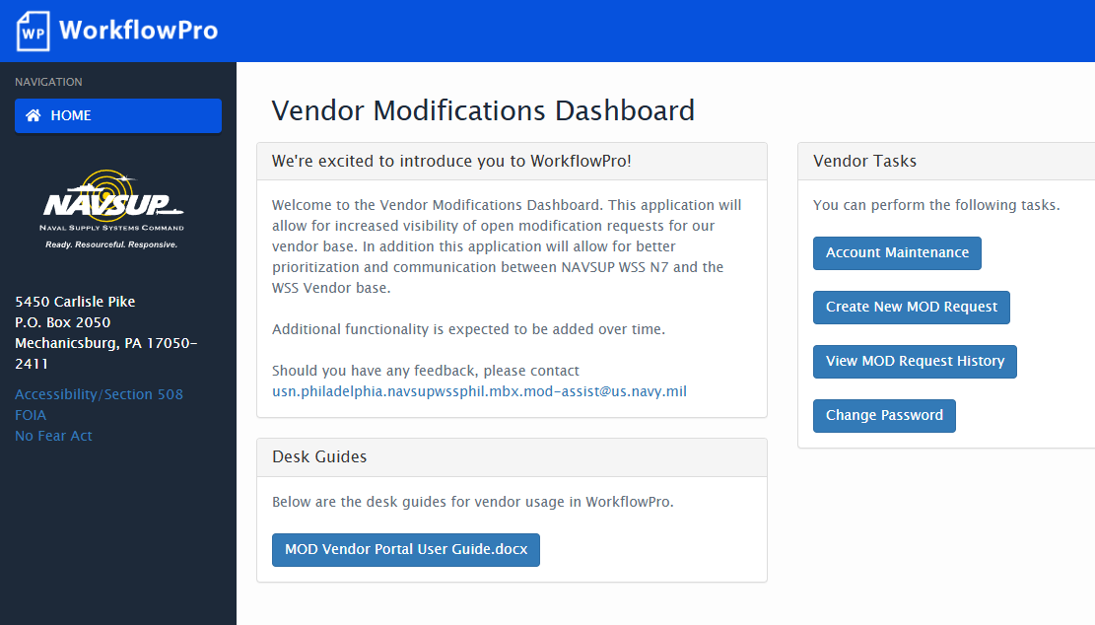
Mod Assist Vendor Portal – Request an account
There are three primary work areas for our vendors
  Account Maintenance
    Create a new request
    Review status/ additional communication
READY. RESOURCEFUL. RESPONSIVE.

Slide 8
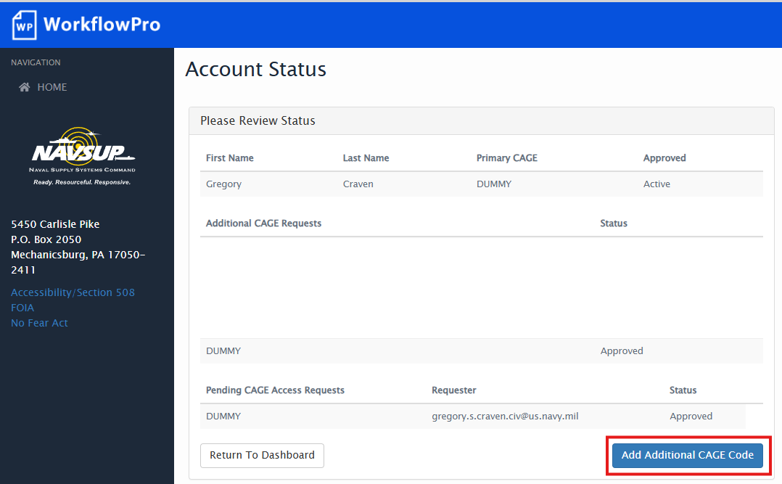
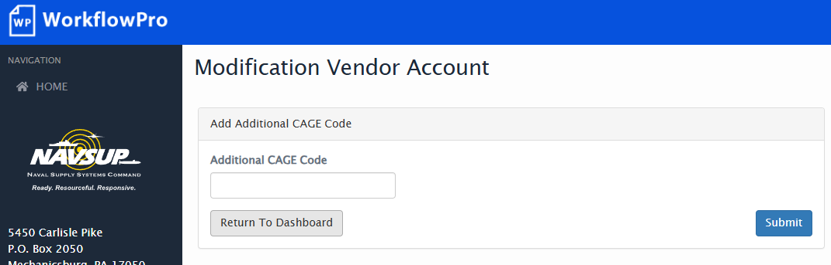
Mod Assist Vendor Portal – Request Additional CAGEs
Account Maintenance
  View Approved CAGEs
  Request Additional CAGEs
    Additional CAGE requests will go to the Point of Contact that approved your initial account request
    Additional CAGEs are needed to submit modifications for contracts awarded to different CAGEs
READY. RESOURCEFUL. RESPONSIVE.

Slide 9
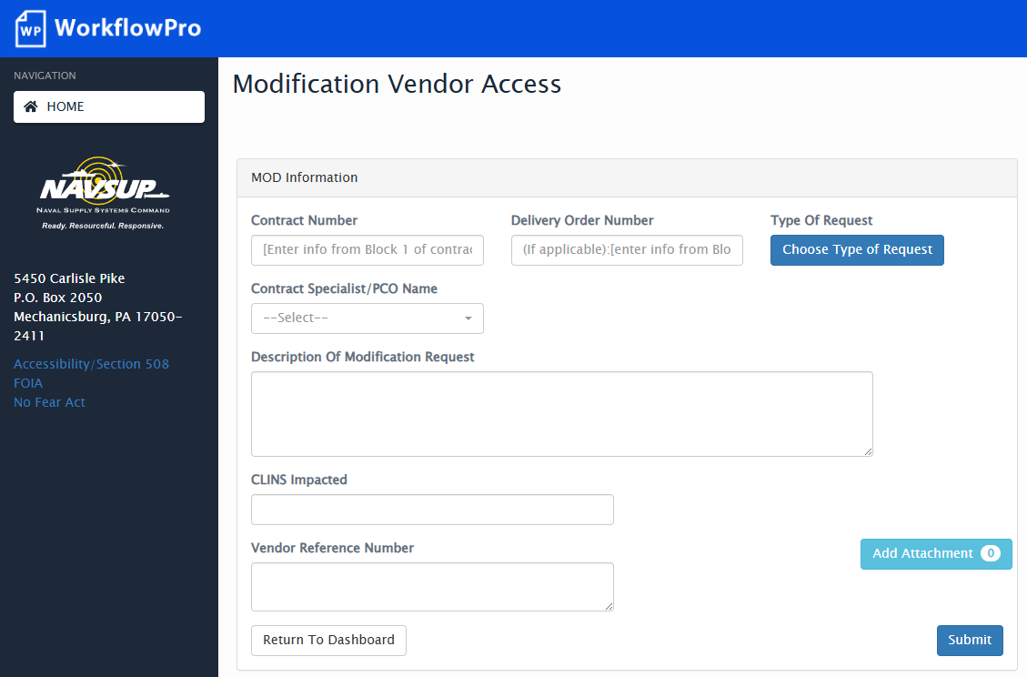
Mod Assist Vendor Portal – Request a modification
Modification requests can be submitted electronically to the appropriate Contracting Officer for review/action
Supporting documents can be attached to the request
Recent Mod Assist updates provide increased visibility of modification requests and seamless re-assignment when POCs are changed.
READY. RESOURCEFUL. RESPONSIVE.

Slide 10
Mod Assist Vendor Portal – Mod Request Validation
Automatic Validation
  Checks the contract number against WSS data to identify the associated CAGE. If the contract is found, the users profile is checked for a matching CAGE, if found the mod request is submitted directly to Mod Assist.
  If the CAGE of the contract does NOT match the user profile, the user will be unable to submit the modification request and will need to request the CAGE be added to their profile.
Manual Validation
  Checks the contract number against WSS data to identify the associated CAGE. If the contract is not found in the data, the user will still be able to submit but the request will need to be manually validated before it is sent to Mod Assist for action.
It is very important to make sure you are entering your contract number correctly. If you have a delivery order against a vehicle that has an “F” in the 9th position (e.g. N00xxx26Fxxx), that is your Contract Number. DO NOT try to put that in the Delivery Order field and do not try to put the vehicle in the Contract Number field. The Delivery Order field is only for pre-FY18 delivery orders that are 4 digits in length.
READY. RESOURCEFUL. RESPONSIVE.

Slide 11
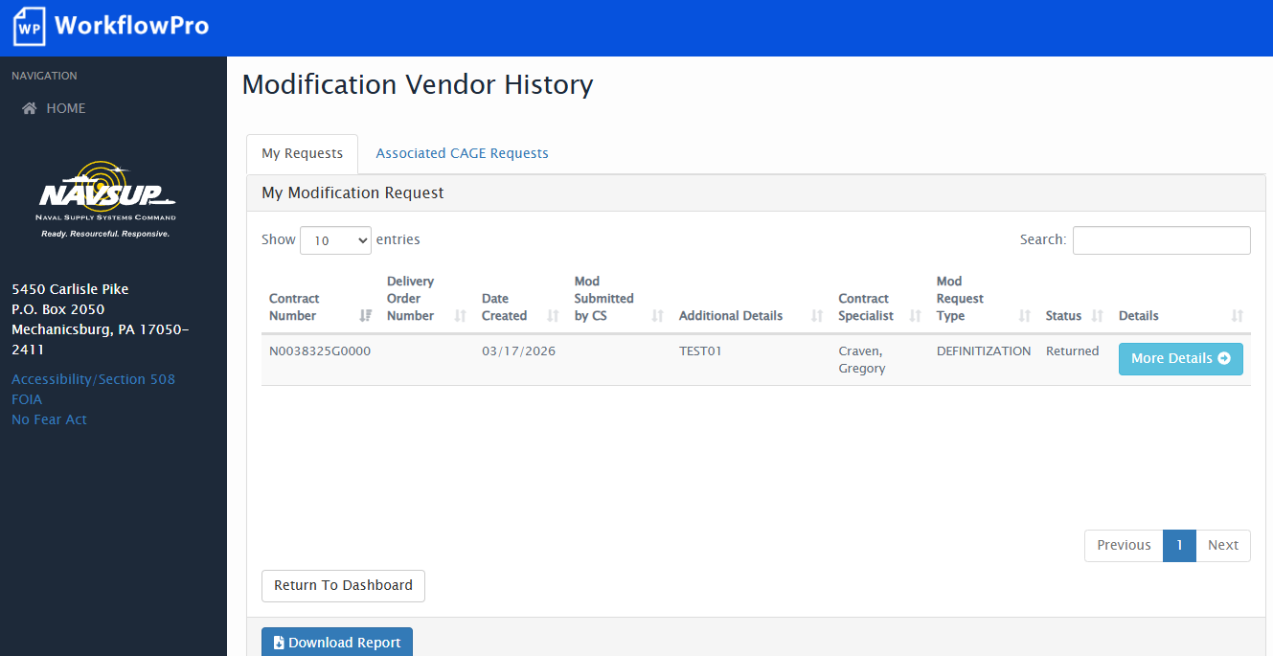
Mod Assist Vendor Portal – Modification status/summary
Vendors can track modification requests in a single location.
  My Requests tab shows requests you submitted
  Associated CAGE Requests tab shows all requests for approved CAGEs in your profile
Comments and limited progress updates of the modification are shared through the vendor portal. With plan for future expansion of functionality.
  We are aware of very limited information available to the users here and we are pursuing a redesign to give more information on open and completed mod requests
READY. RESOURCEFUL. RESPONSIVE.

Slide 12
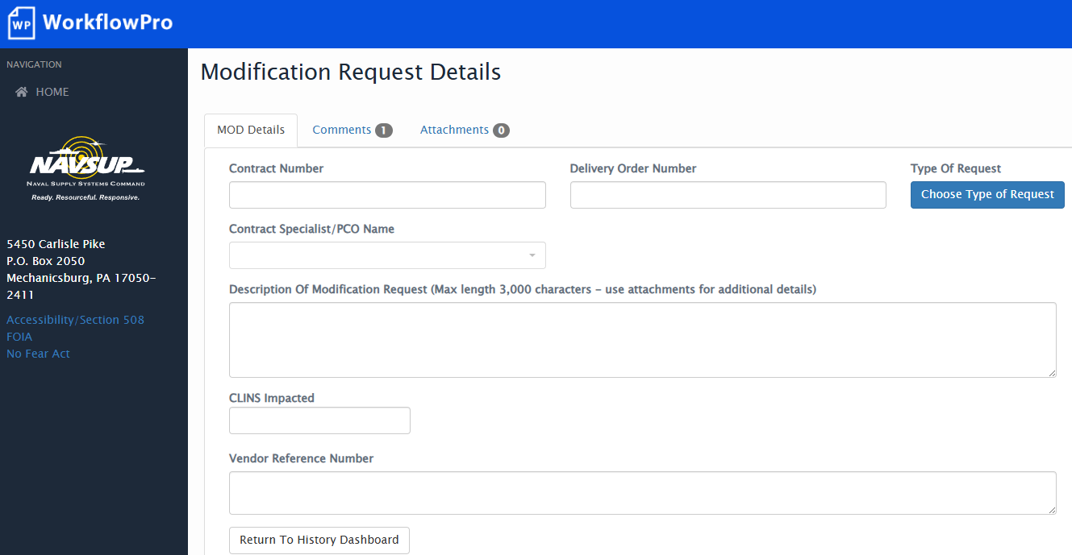
Mod Assist Vendor Portal – Modification Details
Details page allows the user to view the specifics of a mod request.
  Comments tab allows the user to send and receive comments between the Vendor Portal and Mod Assist
READY. RESOURCEFUL. RESPONSIVE.

Slide 13
Mod Assist – Future state
Mod Assist Requested Functionality:
Increased utility of the Mod Request History screen
  Advanced search functionality.
  Better status updates to mod requests including the ability to see and receive notification when a mod request is completed
  Ability to see the current government POC assignment of a mod request
  Archive functionality for inactive and completed mod requests
READY. RESOURCEFUL. RESPONSIVE.

Slide 14
Questions?
Questions?
Mod Assist Support Email Address:
usn.philadelphia.navsupwssphil.mbx.mod-assist@us.navy.mil

